Slide 1
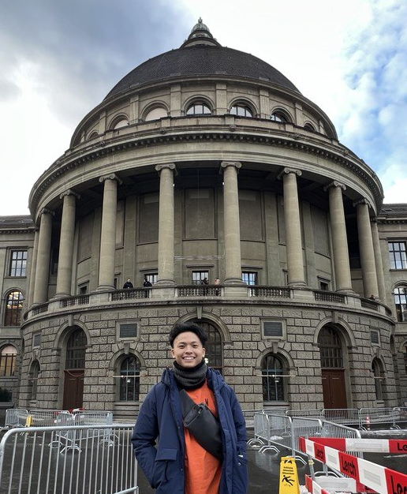
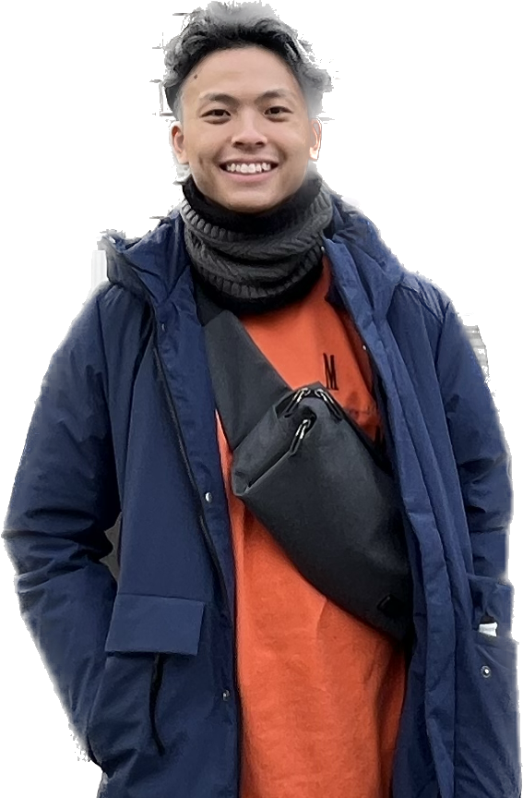
Internship Reflection
Gan Zhen Yang
Machine Learning and Robotics Intern
NUS Year 2 Computer Engineering
8th May 2023 - 28th July 2023

Slide 2
Project – Reinforcement Learning on Corriere LM
Problem statement : Dynamic Mismatch between simulation and real-world robot
May 2023
June 2023
June 2023
July 2023
Simulation setup in Nvidia Isaac Sim
Tuning of differential controller in simulation
Implementation of domain randomization
Implementation of multiagent RL training
Conduct experiment in real world
Integrated 4-wheel robot with NVIDIA Isaac SDK for seamless control and interaction.
Identify the key parameters for domain randomization and create random sample function
Integration of RL local planner and robot’s control system
Iterative process of evaluation of robot’s performance and fine-tuning RL local planner
Integration of state of art RL algorithm
Designed and fine-tuned reward functions
Employed NVIDIA's hardware acceleration technologies to optimize the training process
Iteratively fine-tuned hyperparameters and RL algorithms
Notes:
Add to setup training state of art paper attach link
Keep domain rand
Setup lidar diff controller
Timeline flow
Include setup multiagent
Problem statement

Slide 3
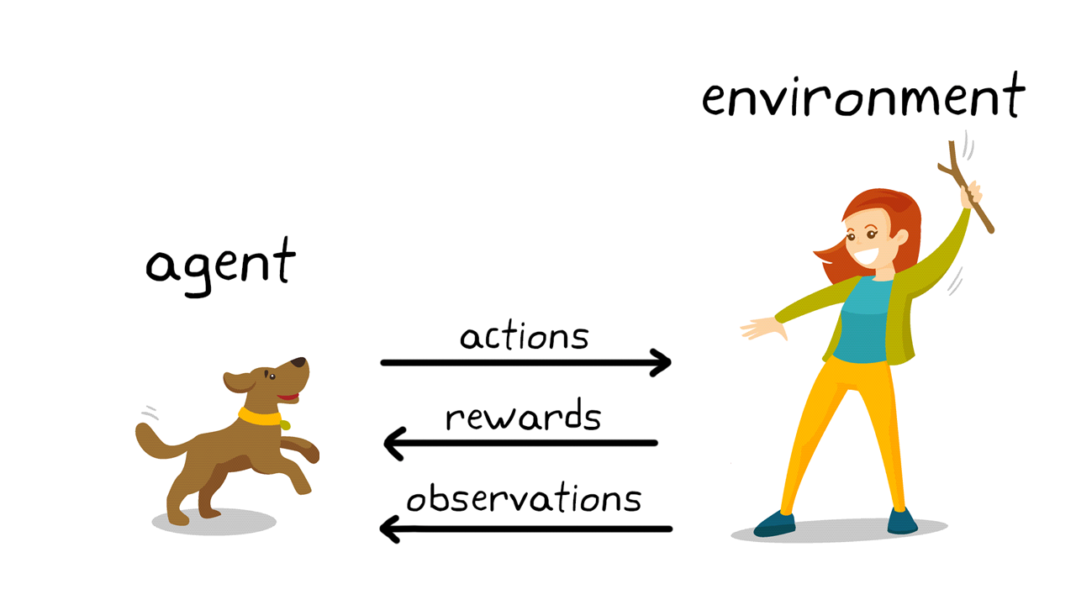

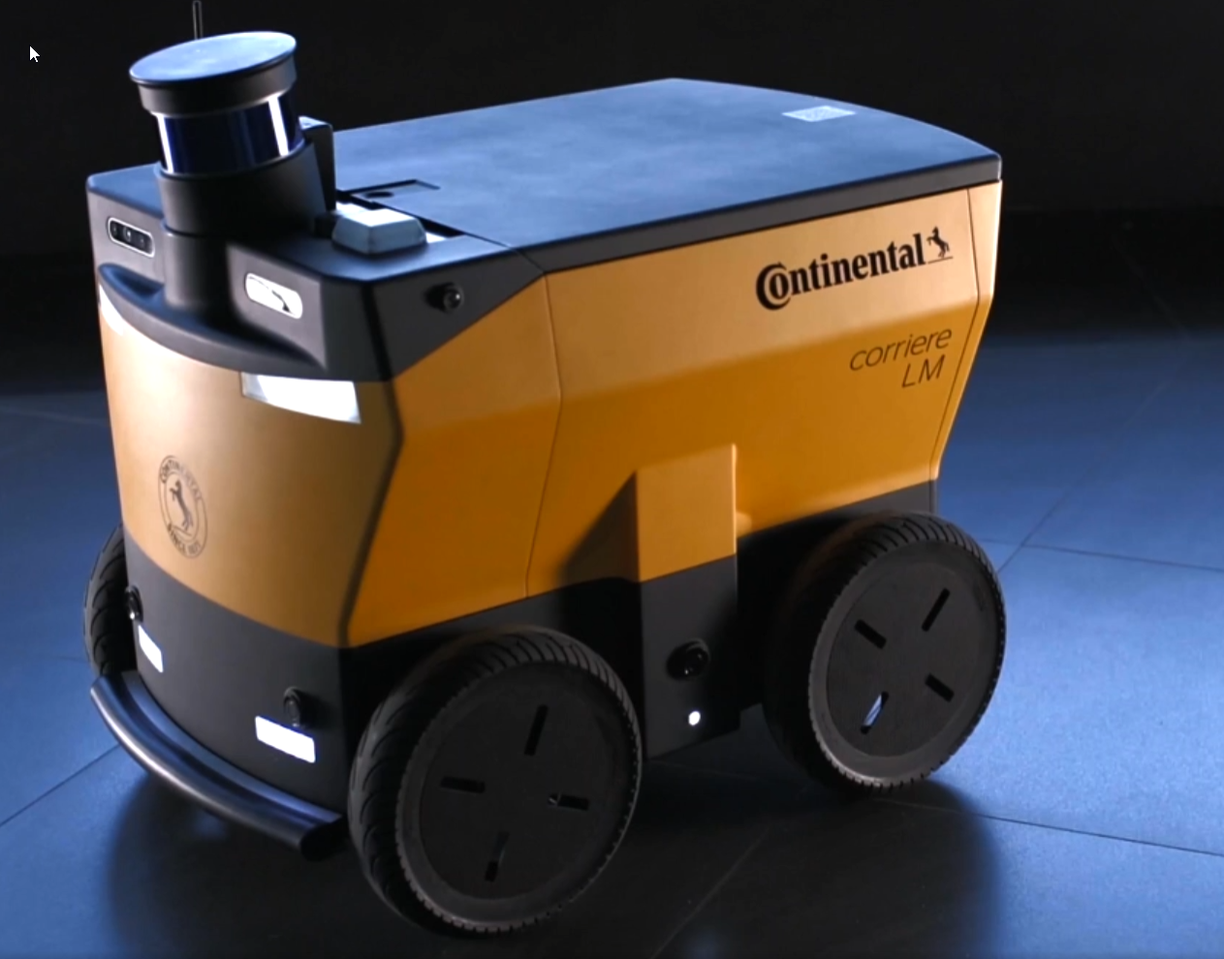
Basic RL training pipeline
Simulation
Reinforcement Learning
Real Robot Deployment

Slide 4
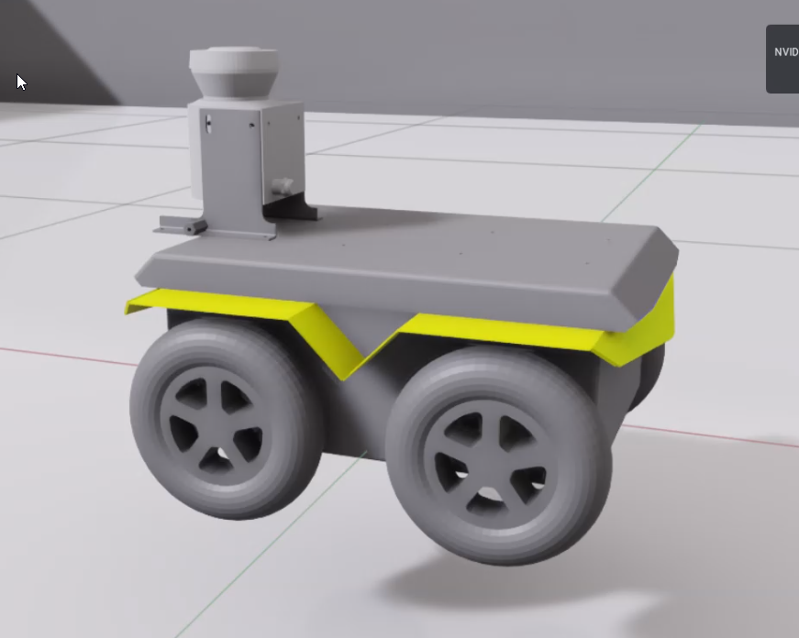
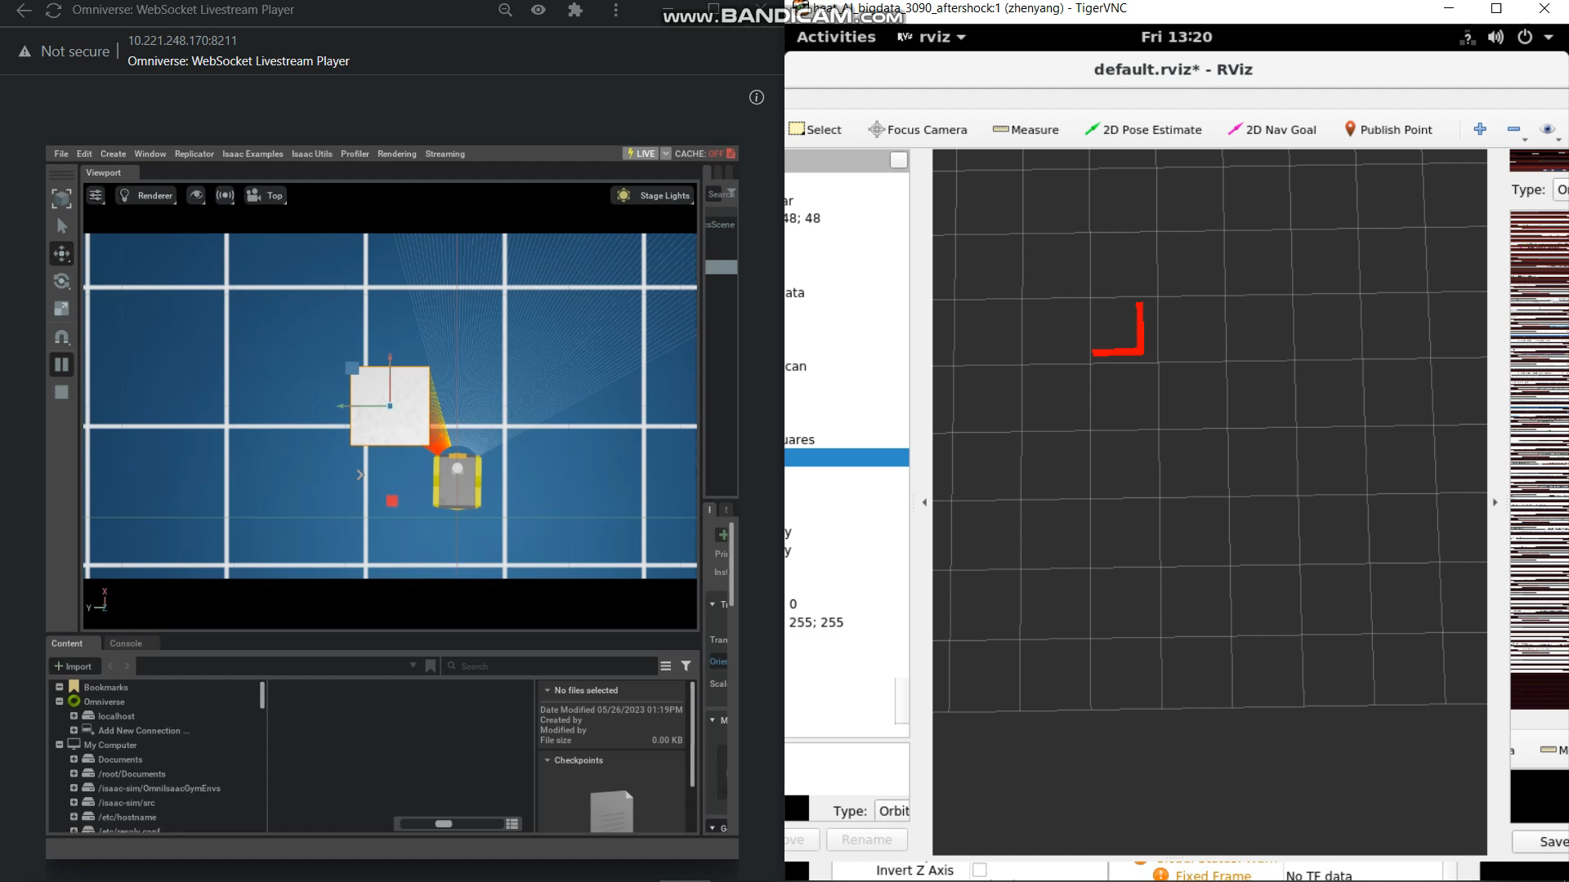
Environment setup in Nvidia Isaac Sim
Notes:
A lot framework ,
Use python script to spwan jackal , verify lidar data stream

Slide 5
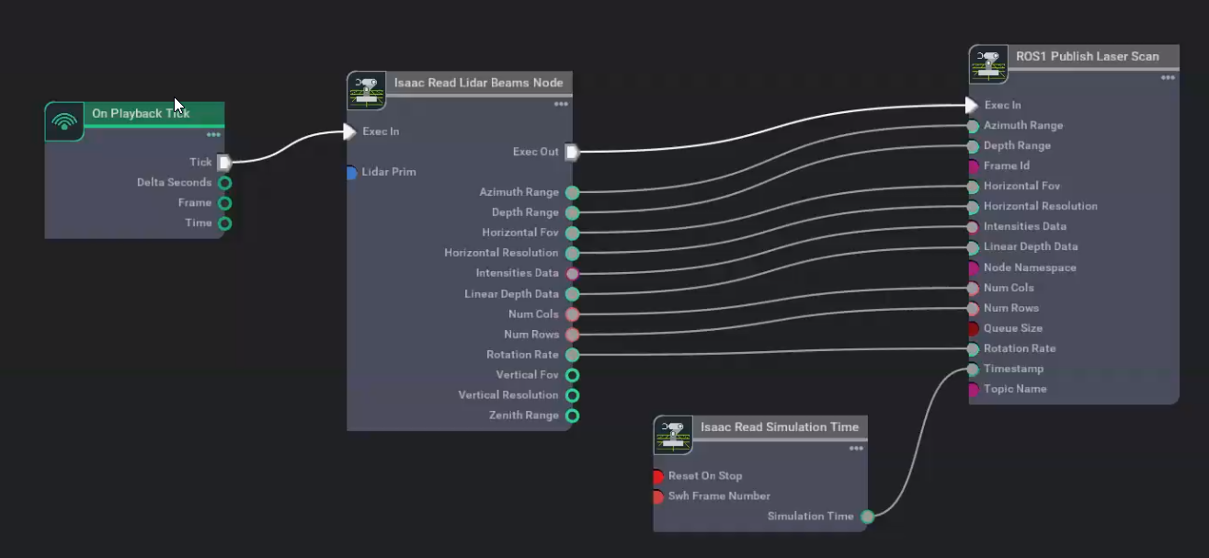
Lidar setup in Isaac Sim : API method vs Action Graph(ROS) method
Notes:
A lot framework ,
Use python script to spwan jackal , verify lidar data stream

Slide 6
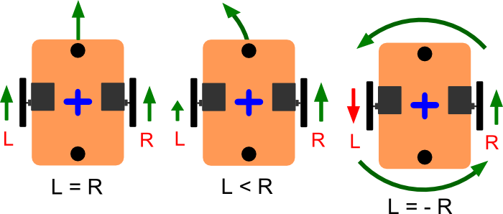
Differential Drive Controller
Notes:
A lot framework ,
Use python script to spwan jackal , verify lidar data stream

Slide 7
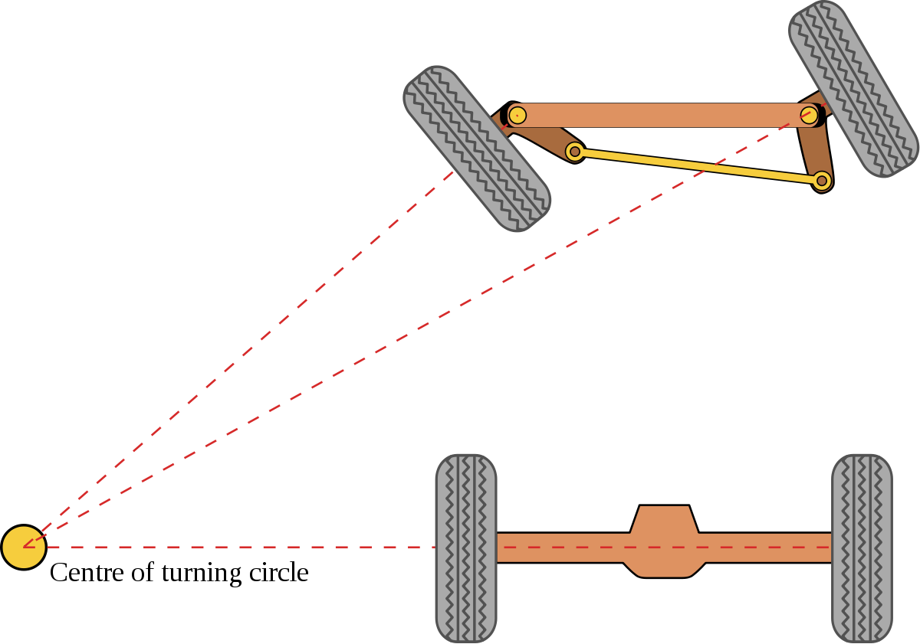
Ackermann steering (control used in vehicle)
Notes:
A lot framework ,
Use python script to spwan jackal , verify lidar data stream

Slide 8

Accelerated simulation step/speed
Slower
Better accuracy
Faster
Lower accuracy
Notes:
A lot framework ,
Use python script to spwan jackal , verify lidar data stream

Slide 9
Integration of state of art RL algorithm
Previous work on collision avoidance:
Centralized vs decentralized
Previous work on decentralized scenarios :
require extracting agent-level features – obstacles positions and size
computationally prohibitive and not robust
Proposed ideas :
Using only sensor-level feature – robot’s velocity, laser scan etc
multi-scenario , multi-stage training framework
Notes:
Previous work on centralized vs decenteralised

Slide 10
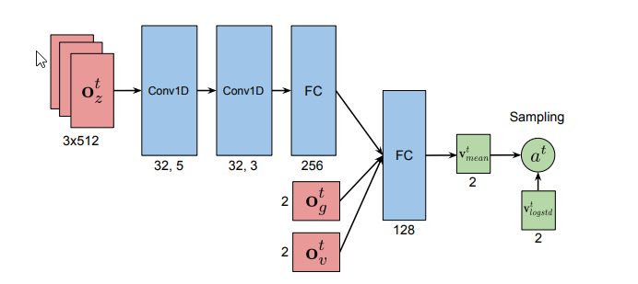
Proposed Neural Network Structure
Laser scan
Dist to goal
Robot velocity
Notes:
multi-scenario , multi-stage training framework
Decentralized -> no communications between agent

Slide 11
Reward Design
Goal reaching reward
Time Penalty
Collision Penalty
Distance to goal reward
Notes:
multi-scenario , multi-stage training framework
Decentralized -> no communications between agent

Slide 12
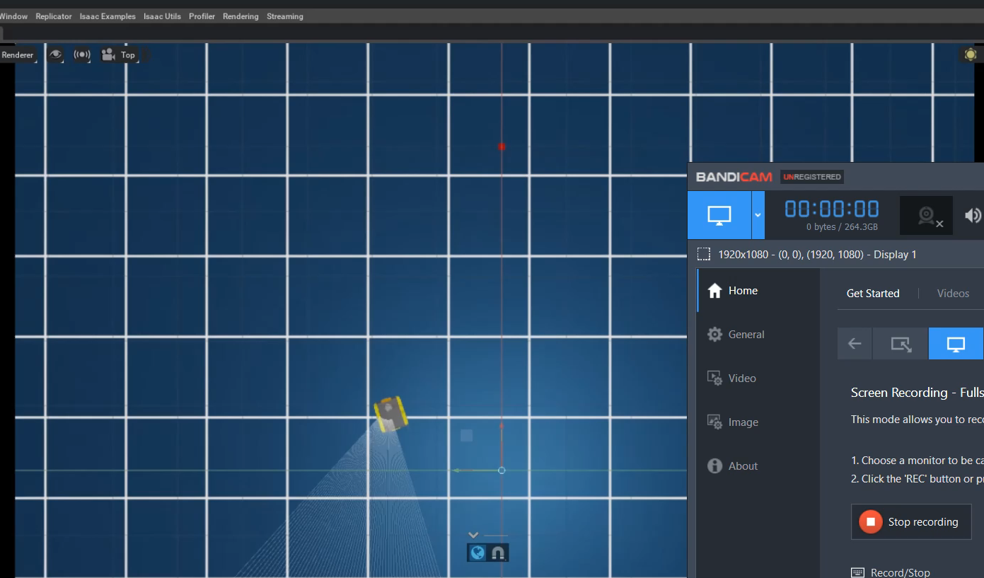
Simple RL training

Slide 13
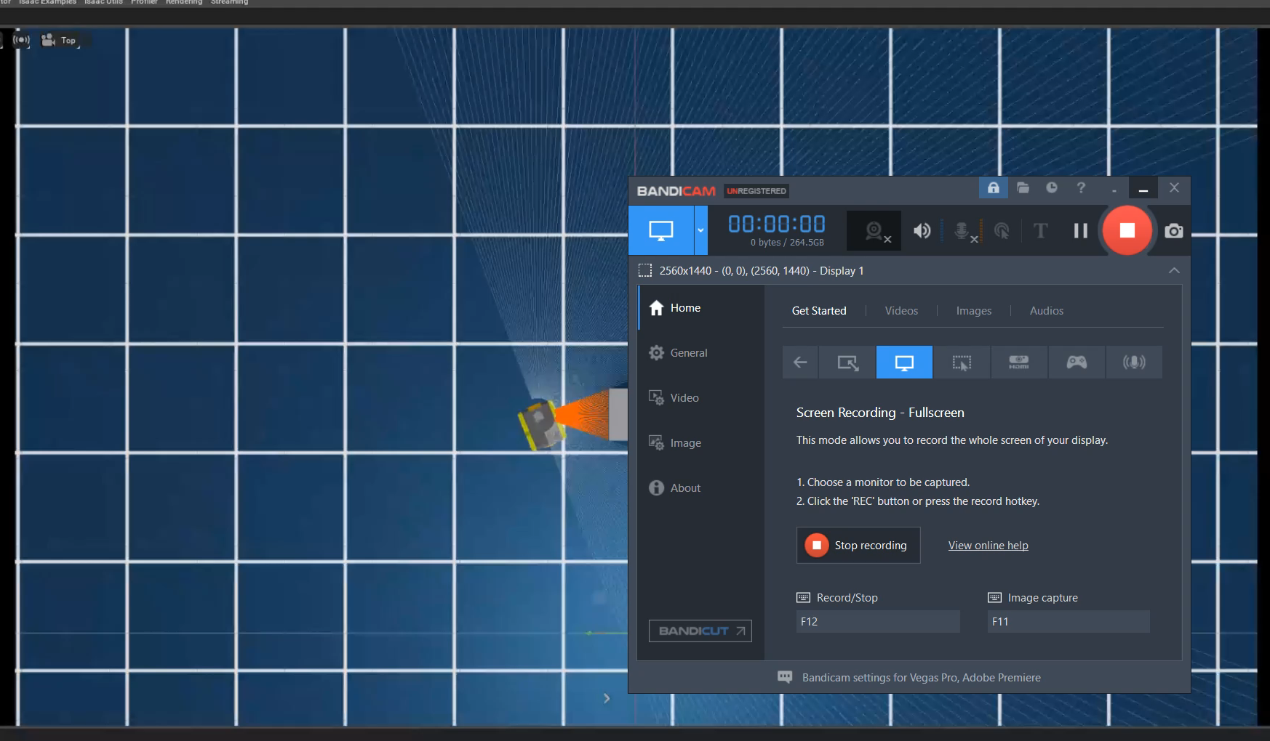
RL training with one obstacles

Slide 14
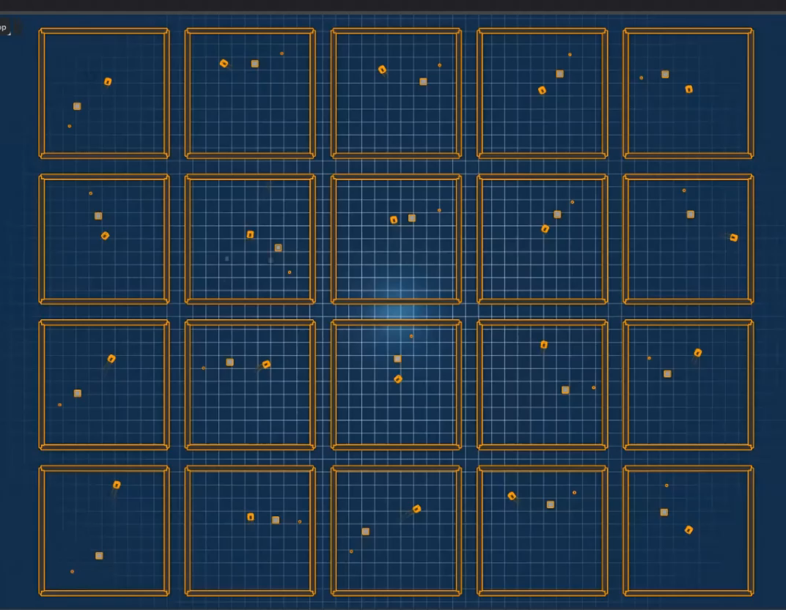
Multiagent RL training
Major Framework Restructure
Vectorisation
Cloning of agent
Individual reset of agent

Slide 15
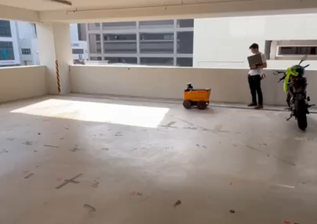
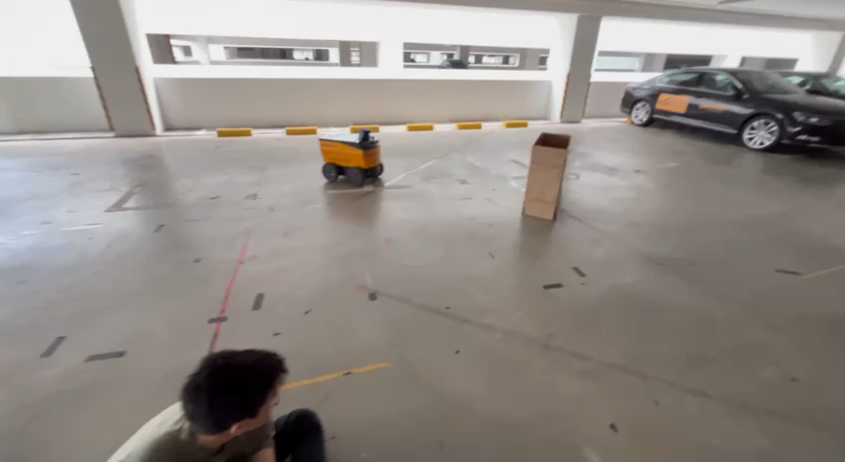
Conducting Real-World Experiments and Evaluation
Notes:
Your contribution might have involved conducting experiments on the real-world Corriere LM system and evaluating its performance after training with the domain-randomized simulations. This could include collecting data from real-world interactions, analyzing the agent's behavior, and comparing the results to those obtained from the simulation environment. Your experiments and evaluations would provide valuable insights into the effectiveness of the proposed Domain Randomization approach

Slide 16
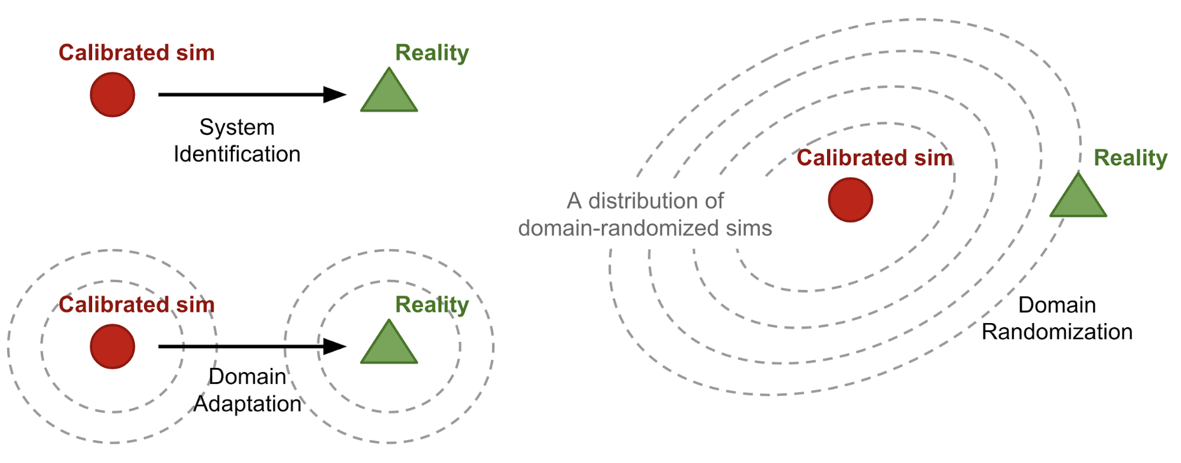
Domain Randomization
Evaluated key parameter that will break the robot
Identified different framework for domain randomization
Direct API set vs Isaac Sim DR stack
Served as baselines for future works :
To expand list of key parameters
To create larger distribution of parameters space
Notes:
In domain adaptation, the model is trained on labeled data from the source domain, where both input features and corresponding labels are available. Then, the model is adapted to the target domain, where labeled data might be scarce or unavailable. The adaptation process aims to align the feature representations learned in the source domain with those in the target domain, enabling the model to generalize better on the target domain.
Robot A, robot B , labelled parameters, testing on dk param

Slide 17
Iterative process of real-world robot testing
Increase complexity of scenario
Success real-world robot testing
Failed real-world robot testing
Reduce complexity of scenario

Slide 18



Startup vs Corporate Culture
Startup
Corporate
Notes:
Poladrone : drone solutions , industrial and agricultural
Kommu : level 2 Autonomous Driving Solution
The smaller team size fosters a strong sense of camaraderie and collaboration. , Startups often require employees to wear multiple hats, exposing you to various aspects of the business. This diverse experience can lead to accelerated learning and skill development.
Corporations have well-defined procedures and processes, providing a stable and organized work environment. In a corporate setting, you may work with specialized teams and experts in various domains, providing opportunities for professional growth and mentorship.

Slide 19
Effective Communication
Asking the right questions
Understanding intentions
Notes:
key characteristics of good questions. : clarity , relevance , depth , neutral , open minded
Key understanding : active listening , pay attention to non verbal cues.

Slide 20
The end

